Slide 1


Daily Review
Think, Pair, Whiteboard, Share: Which forms of energy do the objects below use or release?
Energy Form Pictures
Kinetic: Movement
Heat: Warms things up
Light: Brightness / lets us see
Sound: Vibrating objects / can be heard
Electrical: Movement of electric charges
Elastic: Stored in compressed / stretched objects
Gravitational: Stored in objects high up
Chemical: Stored in chemical bonds
Nuclear: Stored inside atoms

Slide 2
Daily Review
Match the energy form with its definition on your whiteboard.
Energy Form Definition
1 Gravitational A Energy stored by compressed or stretched objects
2 Chemical B Energy stored in the chemical bonds of substances
3 Elastic C Energy stored by being moved higher up
Nuclear D Energy released when the structure of atoms is changed by being split or fused together

Slide 3

Daily Review
Describing energy types
Identify two or three main types of energy used or released by the object Write a full sentence response: The main energy types used or released by a _______ are _________, ________ and _______ energy.
What types of energy are used or released by a light bulb?
The main energy types used or released by a light bulb are light, heat and electrical energy.
Reminder
Kinetic: Movement Heat: Warms things up Light: Brightness / lets us see Sound: Vibrating objects / can be heard Electrical: Movement of electric charges Elastic: Stored in compressed / stretched objects Gravitational: Stored in objects high up Chemical: Stored in chemical bonds Nuclear: Stored inside atoms

Slide 4
Kinetic and Potential Energy Year 8 Science

Slide 5

Learning Objectives
CFU
What are we going to learn?
Identify and describe forms of kinetic energy.
Identify and describe forms of potential energy.
Activate Prior Knowledge
We have learnt about many different forms of energy. Sound energy is produced by objects vibrating; elastic energy is stored by compressed or stretched objects.
Think, Pair, Share: How is sound energy different to elastic energy?

Slide 6
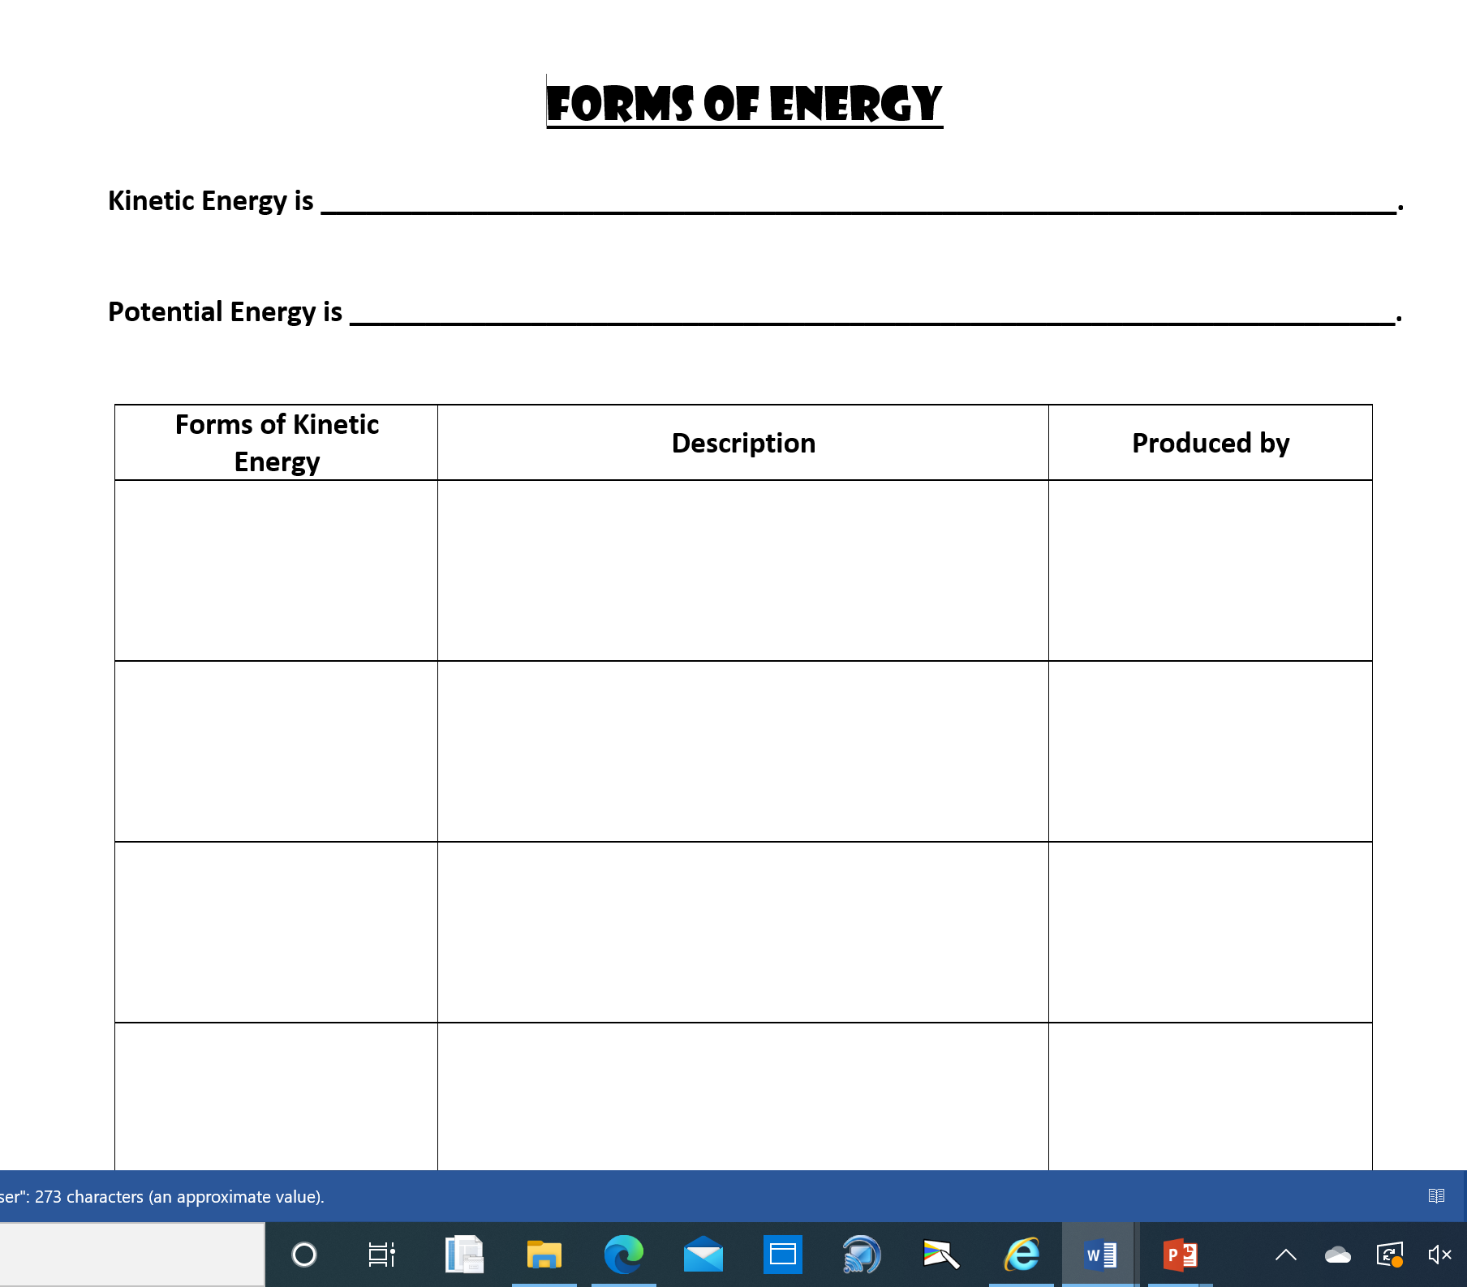
Skill Development
Collect a Graphic Organiser and complete it using the information from the following slides.

Slide 7


Concept Development
CFU 1
What is kinetic energy?
CFU 2
Which has more kinetic energy – a car travelling at 60 km/h or the same car travelling at 100 km/h? Explain your choice.
Kinetic Energy
Kinetic energy is the energy of movement.
The faster an object moves, the more kinetic energy it has.
CFU 3
What are the 4 forms of kinetic energy?
Forms of Kinetic Energy
1. Heat Energy 2. Light Energy 3. Sound Energy 4. Electrical Energy

Slide 8

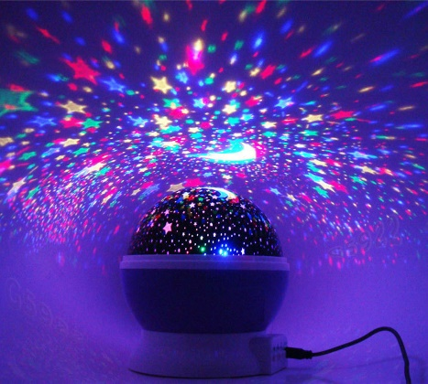
Concept Development
CFU 1
What is moving in heat energy?
Kinetic Energy – the energy of movement
Forms of Kinetic Energy:
1. Heat Energy – energy that can warm things up. Energy an object has because of the movement of its particles.
Produced by: fire, friction, the sun
2. Light Energy – energy given off by luminous objects, which enables us to see. Made of photons: tiny packets of energy that move at the speed of light.
Produced by: stars, light bulbs, candles
CFU 2
What is moving in light energy?

Slide 9
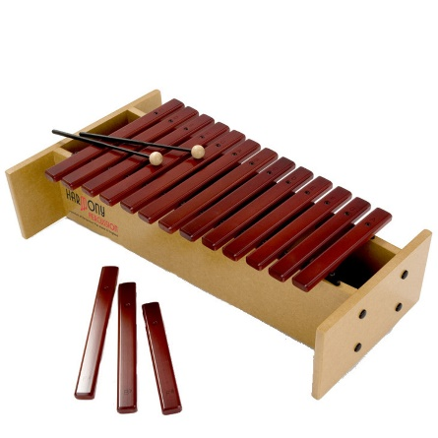
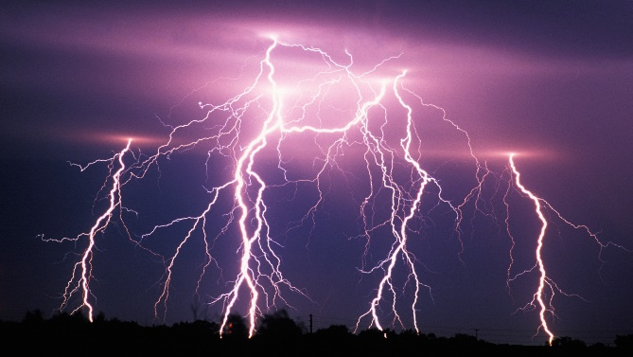
Concept Development
CFU 1
What is moving in sound energy?
Kinetic Energy – the energy of movement
Forms of Kinetic Energy:
3. Sound Energy – energy that is produced by objects vibrating. These vibrations can travel through air (or other substances) to our ears.
Produced by: voices, speakers, musical instruments
4. Electrical Energy – energy supplied by the movement of charged particles. Usually involves electrons moving through wires.
Produced by: solar cells, lightning, batteries
CFU 2
What is moving in electrical energy?

Slide 10

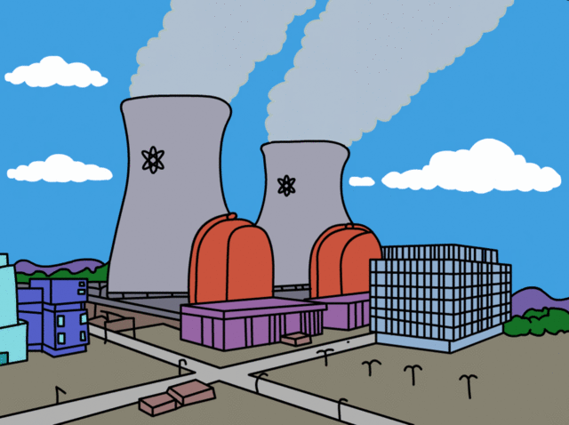
Concept Development
CFU 1
What is potential energy?
Potential Energy
Potential energy is stored in objects; it is held until it is used.
Because of this stored energy, these objects have the potential to make things happen.
CFU 2
Think, Pair, Share: Name two examples of potential energy.
CFU 3
What are the 4 forms of potential energy?
Forms of Potential Energy
1. Elastic Energy 2. Gravitational Energy 3. Chemical Energy 4. Nuclear Energy

Slide 11
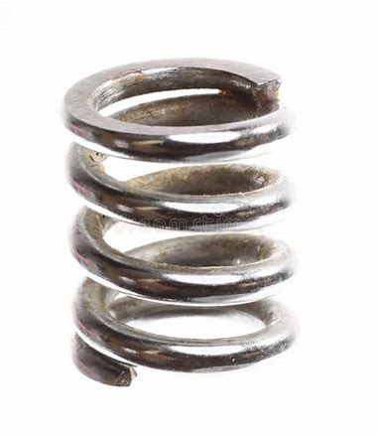

Concept Development
CFU 1
Where is energy stored in elastic energy?
Potential Energy – stored energy
Forms of Potential Energy:
1. Elastic Energy – energy stored by compressed, stretched, twisted or flexed objects. Released when the object is let go and returns to its original shape.
Held by: elastic band, spring, bowstring
2. Gravitational Energy – energy stored by objects as they are moved away from the Earth (or another object with mass). More height means more potential energy.
Held by: water at the top of a waterfall, a person at the top of a slide
CFU 2
Where is energy stored in gravitational energy?

Slide 12

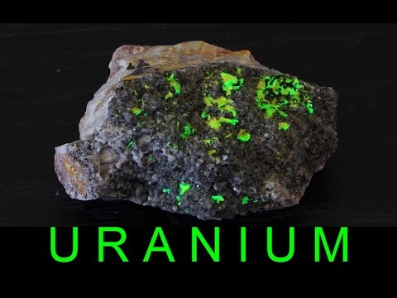
Concept Development
CFU 1
Where is energy stored in chemical energy?
Potential Energy – stored energy
Forms of Potential Energy:
3. Chemical Energy – energy stored in the chemical bonds of substances. Can be released through chemical reactions.
Held by: food, wood, batteries
4. Nuclear Energy – energy stored in the bonds within atoms. Released when atoms are split apart (nuclear fission) or joined together (nuclear fusion).
Held by: uranium, plutonium
CFU 2
Where is energy stored in nuclear energy?

Slide 13

Skill Development / Guided Practice
Classifying energy into types
Is the energy stored? Yes = potential Does the energy involve movement? Yes = kinetic Write a full sentence response: ______ is a form of _______ energy because _________.
Trees have chemical energy. What group of energy does this belong to?
Chemical energy is a form of potential energy because it is stored.
Reminder
Kinetic: Movement Heat: Warms things up Light: Brightness / lets us see Sound: Vibrating objects / can be heard Electical: Movement of electric charges Elastic: Stored in compressed / stretched objects Gravitational: Stored in objects high up Chemical: Stored in chemical bonds Nuclear: Stored inside atoms

Slide 14
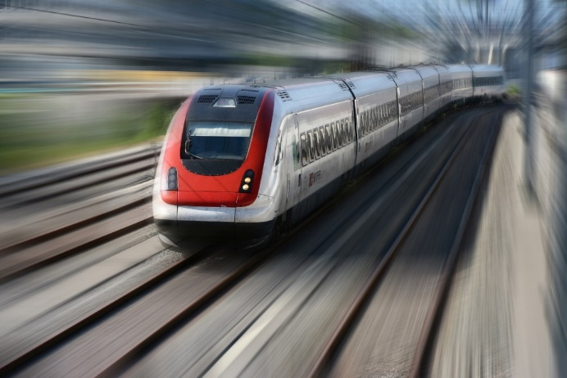
Skill Development / Guided Practice
Classifying energy into types
Is the energy stored? Yes = potential Does the energy involve movement? Yes = kinetic Write a full sentence response: ______ is a form of _______ energy because _________.
Trains produce sound energy. What group of energy does this belong to?
Sound energy is a form of kinetic energy because it involves movement.
Reminder
Kinetic: Movement Heat: Warms things up Light: Brightness / lets us see Sound: Vibrating objects / can be heard Electrical: Movement of electric charges Elastic: Stored in compressed / stretched objects Gravitational: Stored in objects high up Chemical: Stored in chemical bonds Nuclear: Stored inside atoms

Slide 15
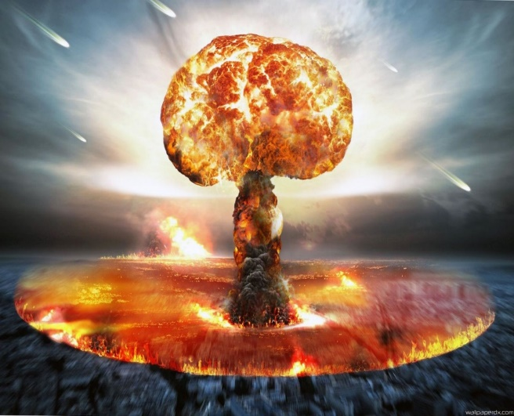
Skill Development / Guided Practice
Classifying energy into types
Is the energy stored? Yes = potential Does the energy involve movement? Yes = kinetic Write a full sentence response: ______ is a form of _______ energy because _________.
Nuclear bombs have nuclear energy. What group of energy does this belong to?
Nuclear energy is a form of potential energy because it is stored.
Reminder
Kinetic: Movement Heat: Warms things up Light: Brightness / lets us see Sound: Vibrating objects / can be heard Electrical: Movement of electric charges Elastic: Stored in compressed / stretched objects Gravitational: Stored in objects high up Chemical: Stored in chemical bonds Nuclear: Stored inside atoms

Slide 16
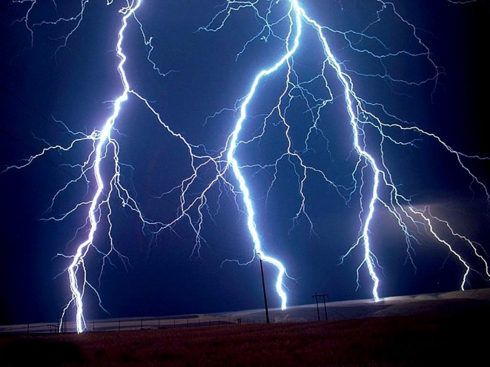
Skill Development / Guided Practice
Classifying energy into types
Is the energy stored? Yes = potential Does the energy involve movement? Yes = kinetic Write a full sentence response: ______ is a form of _______ energy because _________.
Lightning produces light energy. What group of energy does this belong to?
Light energy is a form of kinetic energy because it involves movement.
Reminder
Kinetic: Movement Heat: Warms things up Light: Brightness / lets us see Sound: Vibrating objects / can be heard Electrical: Movement of electric charges Elastic: Stored in compressed / stretched objects Gravitational: Stored in objects high up Chemical: Stored in chemical bonds Nuclear: Stored inside atoms

Slide 17
Relevance
Why do energy types matter?
You can only experience the effects of kinetic energy, and all kinetic energy was stored as potential energy at some point.
Understanding these types of energy will help to understand and predict transformations between them.
Kinetic Energy
Heat: Warms things up Light: Brightness / lets us see Sound: Vibrating objects / can be heard Electrical: Movement of electric charges
Potential Energy
Elastic: Stored in compressed / stretched objects Gravitational: Stored in objects high up Chemical: Stored in chemical bonds Nuclear: Stored inside atoms

Slide 18


Skill Closure
What is the difference between kinetic and potential energy?
Identify the forms of kinetic energy in the pictures below.
a) b)
Identify the forms of potential energy in the pictures below.
a) b)

Slide 19
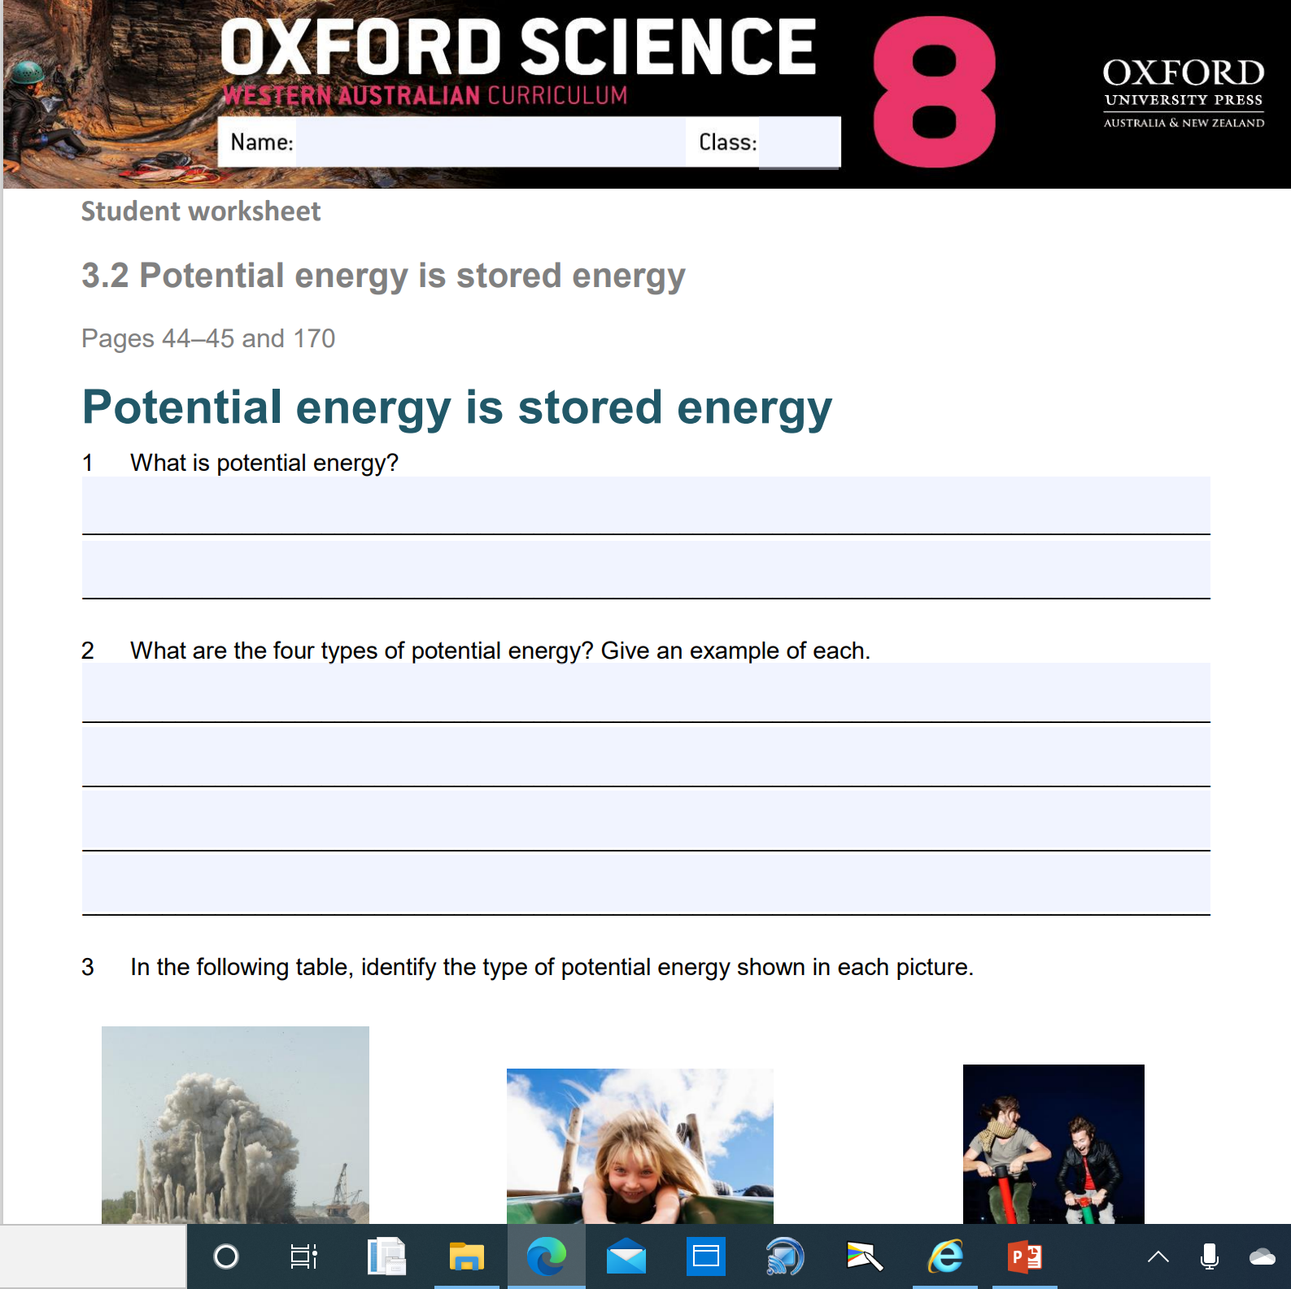
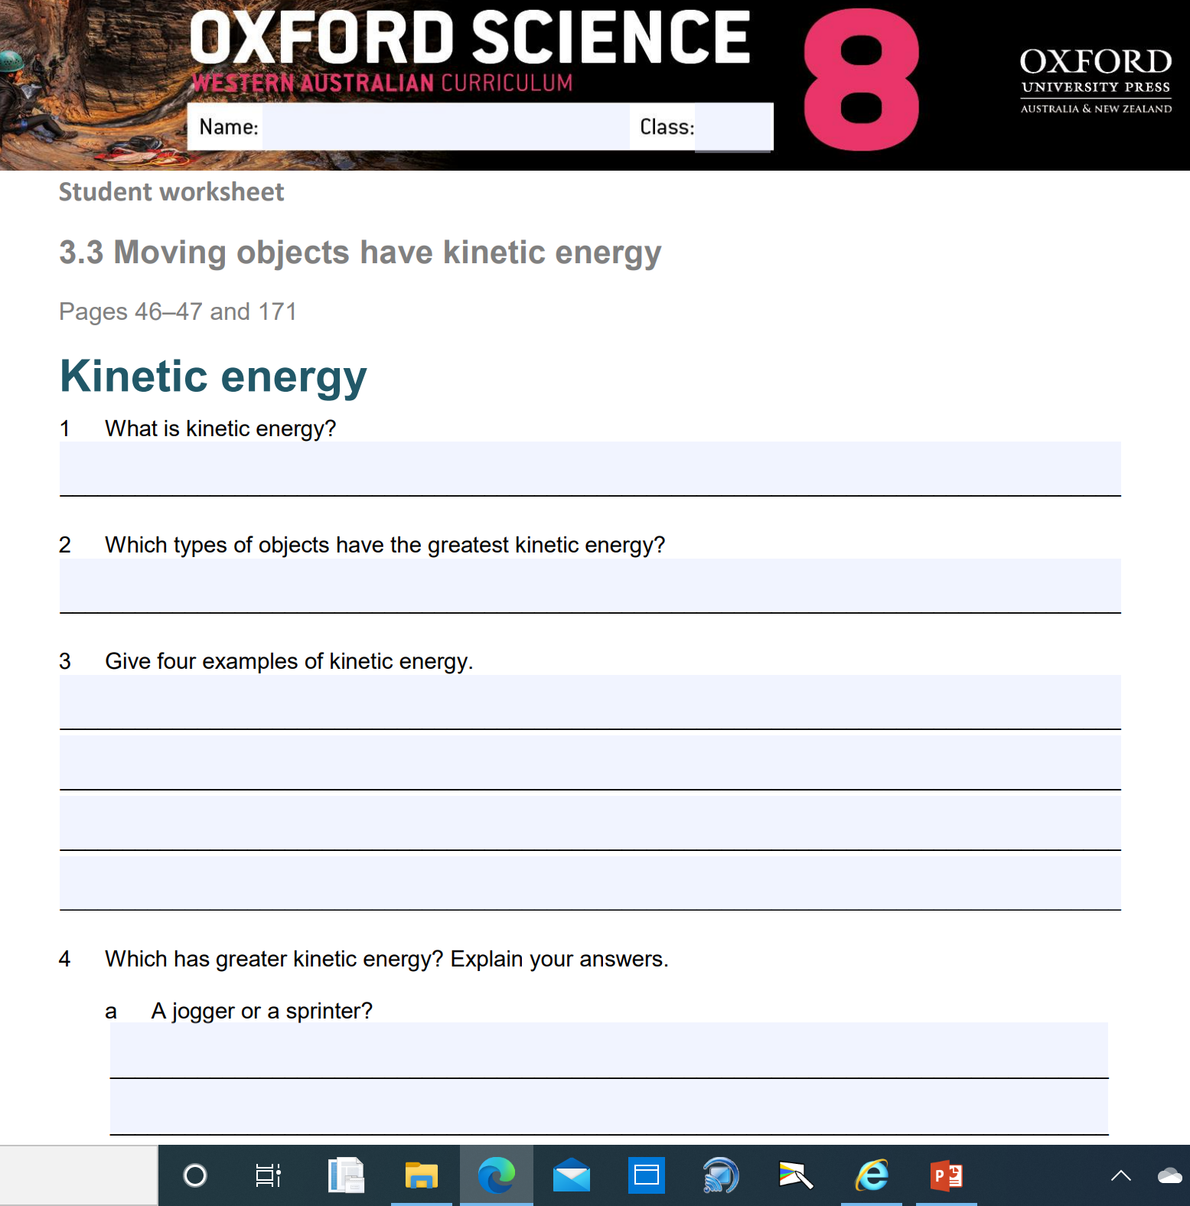
Independent Practice
Complete Oxford Science 8 Worksheets:
3.2 Potential Energy
3.3 Kinetic Energy

